Slide 1
Chinese-context Research
SHUI Yuan
Saturday Reading Group
22-Oct-2022

Slide 2
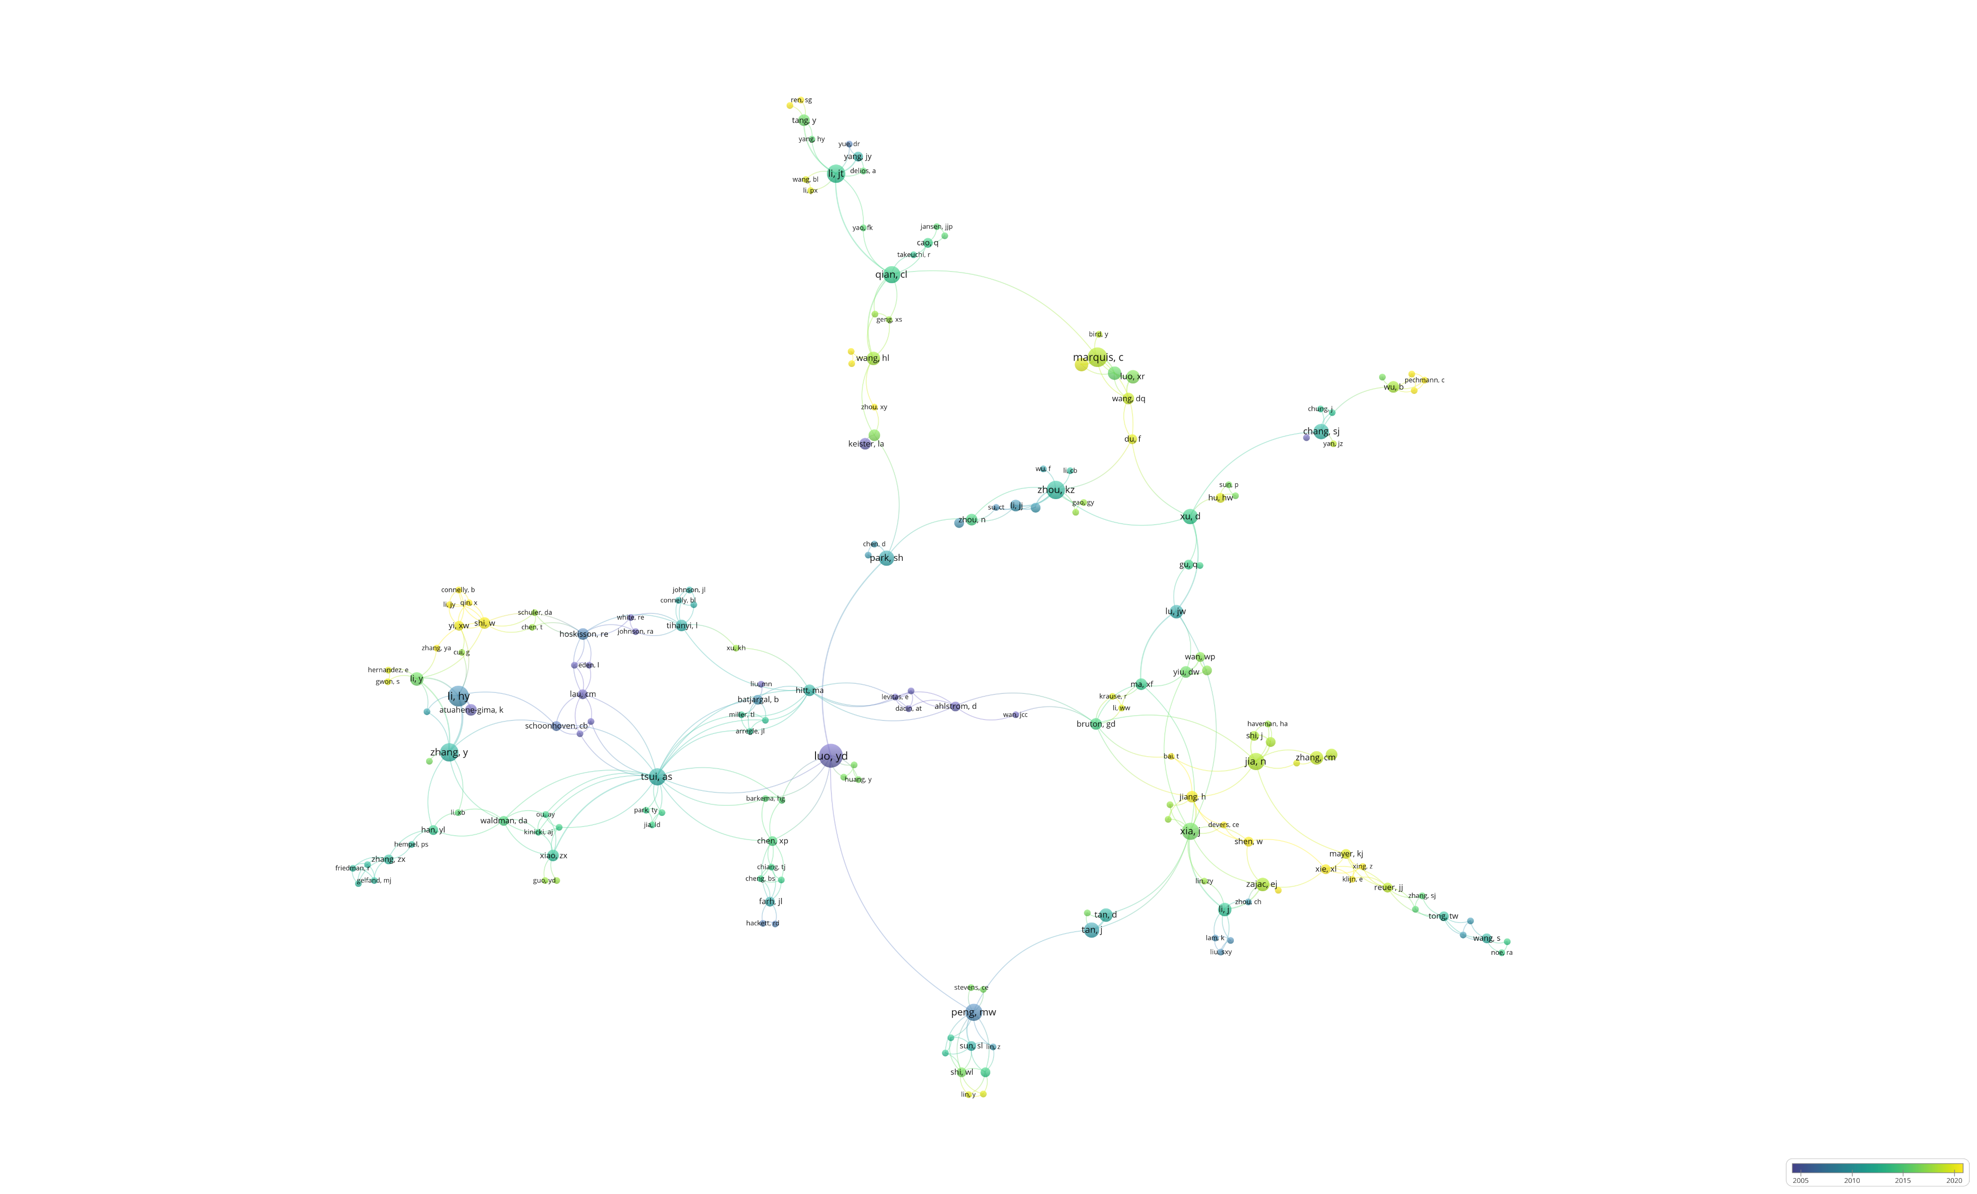
Scholars studying the Chinese context

Slide 3
Christopher MARQUIS

Slide 4
Nan JIA

Slide 5
Han JIANG

Slide 6
Wei SHI

Slide 7
Helen Wei HU

Slide 8
Scholars studying the Chinese context

Slide 9
1. 2015-2020
Christopher MARQUIS
Professor, Sustainable Global Enterprise at the Cornell SC Johnson College of Business
EMPLOYMENT
University of Cambridge
Cornell University
Harvard University
EDUCATION
University of Michigan
PhD in Sociology & Business Administration, 2005
MA in Sociology, 2002
University of Pittsburgh
MBA in Finance, 1994
MA in History (focus on Chinese history), 1993
RESEARCH TOPICS
Chris studies how the interaction between civil society, governments, and corporations leads to socially and environmentally beneficial outcomes, with a particular emphasis on how these processes unfold in China.
EDITORIAL BOARD MEMBER

Slide 10
1. 2015-2020
Marquis and Qiao, 2020 | ASQ | imprinting theory | Communist ideological imprint | internationalization processes
Wang, Du, and Marquis, 2019 | AMJ | political ideology | mayor’s communist ideology | political appointment
Marquis and Bird, 2018 | OS | civic activism
Luo, Zhang, and Marquis, 2016 | AMJ
Zhang, Marquis, and Qiao, 2016 | OS
Marquis and Qian, 2014 | OS

Slide 11
1. 2015-2020
Christopher MARQUIS
Marquis and Qiao, 2020 (ASQ): imprinting theory, ideological imprinting, political ideology and organizations, internationalization of Chinese firms, entrepreneurship in China
Wang, Du, and Marquis, 2019 (AMJ): political ideology
Marquis and Bird, 2018 (OS): civic activism, authoritarianism, China, regulation, corporate sustainability
Luo, Zhang, and Marquis, 2016 (AMJ): Internet activism
Zhang, Marquis, and Qiao, 2016 (OS): political connections; corporate charitable donation; resource dependence; institutional environment
Marquis and Qian, 2014 (OS): institutional theory; political strategy; nonmarket strategy; emerging markets; China; corporate social responsibility

Slide 12
1. 2015-2020
Kunyuan Qiao
Danqing Wang
Yanhua Bird
Xiaowei Rose Luo
Jianjun Zhang
Cuili Qian

Slide 13
1. 2015-2020
Christopher MARQUIS
Professor, Sustainable Global Enterprise at the Cornell SC Johnson College of Business
EMPLOYMENT
University of Cambridge
Cornell University
Harvard University
EDUCATION
University of Michigan
PhD in Sociology & Business Administration, 2005
MA in Sociology, 2002
University of Pittsburgh
MBA in Finance, 1994
MA in History (focus on Chinese history), 1993
RESEARCH TOPICS
Chris studies how the interaction between civil society, governments, and corporations leads to socially and environmentally beneficial outcomes, with a particular emphasis on how these processes unfold in China.
EDITORIAL BOARD MEMBER

Slide 39
1. 2015-2020
Christopher MARQUIS
Marquis C, Qiao K. 2020. Waking from Mao’s dream: Communist ideological imprinting and the internationalization of entrepreneurial ventures in China. Administrative Science Quarterly 65(3): 831–833.
Wang D, Du F, Marquis C. 2019. Defending Mao’s dream: How politicians’ ideological imprinting affects firms’ political appointment in China. Academy of Management Journal 62(4): 1111–1136.
Marquis C, Bird Y. 2018. The paradox of responsive authoritarianism: How civic activism spurs environmental penalties in China. Organization Science 29(5): 948–968.
Luo X, Zhang J, Marquis C. 2016. Mobilization in the internet age: Internet activism and corporate response. Academy of Management Journal 59(6): 2045–2068.
Zhang J, Marquis C, Qiao K. 2016. Do political connections buffer firms from or bind firms to the government? A study of corporate charitable donations of Chinese firms. Organization Science 27(5): 1307–1324.
Marquis C, Qian C. 2014. 4Corporate social responsibility reporting in China: Symbol or substance? Organization Science 25(1): 127–148.

